Slide 1

Home Services and Personal Care Application
Python Mini Project
By
Arisha Chadha
&
Aastha Bhardwaj

Slide 2

This project presents an online marketplace connecting service providers with service seekers. The platform offers a wide range of services, from beauty treatments to home cleaning, delivered conveniently at home.

Slide 3
System Description
Welcome Screen
The application starts with a welcome screen, guiding users to the main menu.
Main Menu
The main menu offers options for sign-in, sign-up, and exiting the application.
User Login
Logged-in users can access features like viewing history, selecting services, scheduling appointments, and managing payments.
Service Options
Users can choose from a variety of services, including beauty treatments, massages, home cleaning, and more.

Slide 4
Database
SQL/MySQL
The application uses SQL/MySQL to create and manage a database that securely stores essential information.
Data Storage
The database stores user credentials, booking history, available services, and payment details.
Relational Database
The relational database structure ensures efficient organization and retrieval of data, enabling a smooth user experience.

Slide 5
Database Structure
customer
Stores customer details such as user name, password, address, ph no, and email.
services
Contains details of available services, such as service name and rates.
schedule
Stores customer schedules, including user, service, service date, Time service, and Total bill.

Slide 6
Libraries Used
mysql.connector : | Connecting to the MySQL database and executing SQL queries.
String : | Basic string operations like formatting and concatenation.
input() : | User interaction for inputting data.
print() : | Displaying messages and results to the user.
cur.execute() and cur.fetchall() : | Executing SQL commands and fetching results from the database.
con.commit() : | Committing changes made to the database.

Slide 7
Code Explanation
login() and sign in()
The login function checks if the username exists and validates the password. The sign-in function registers a new customer in the customer table.
schedule()
Allows customers to select a service, provide a date and time, and calculate the total bill. This function inserts the customer’s service schedule into the schedule table.
update()
Provides an interface for users to update the service schedule. It includes options to update the date, time, or service and adjusts the total bill if the service is changed.
delete details()
Allows users to delete specific records based on service, date, or time.

Slide 8
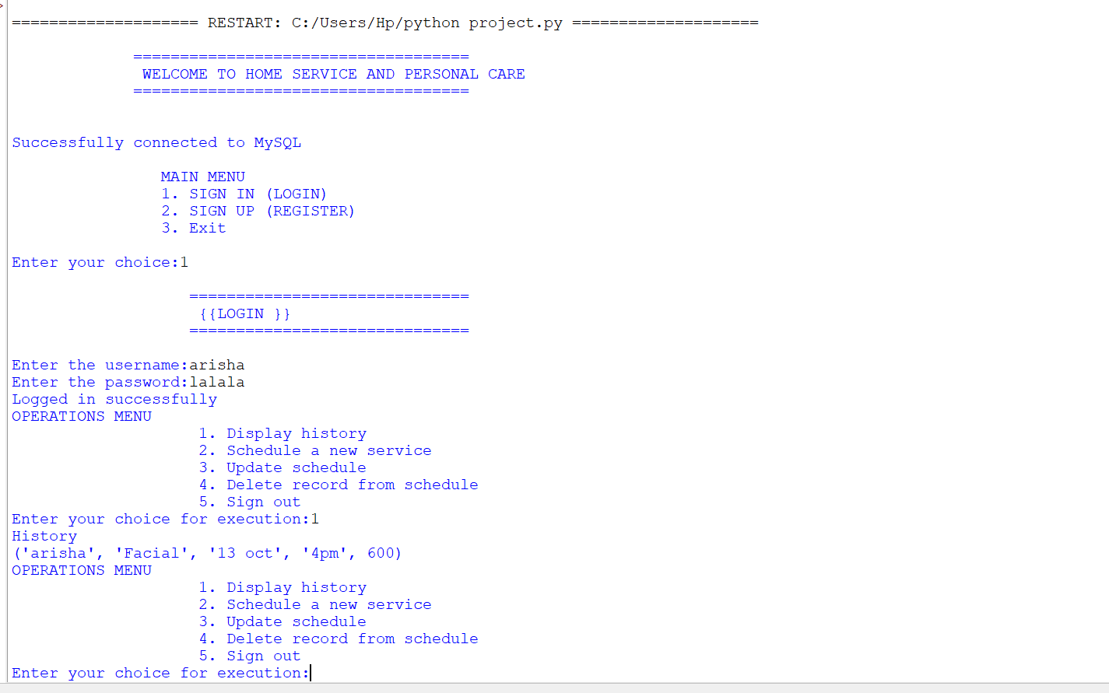
SCREENSHOTS

Slide 9
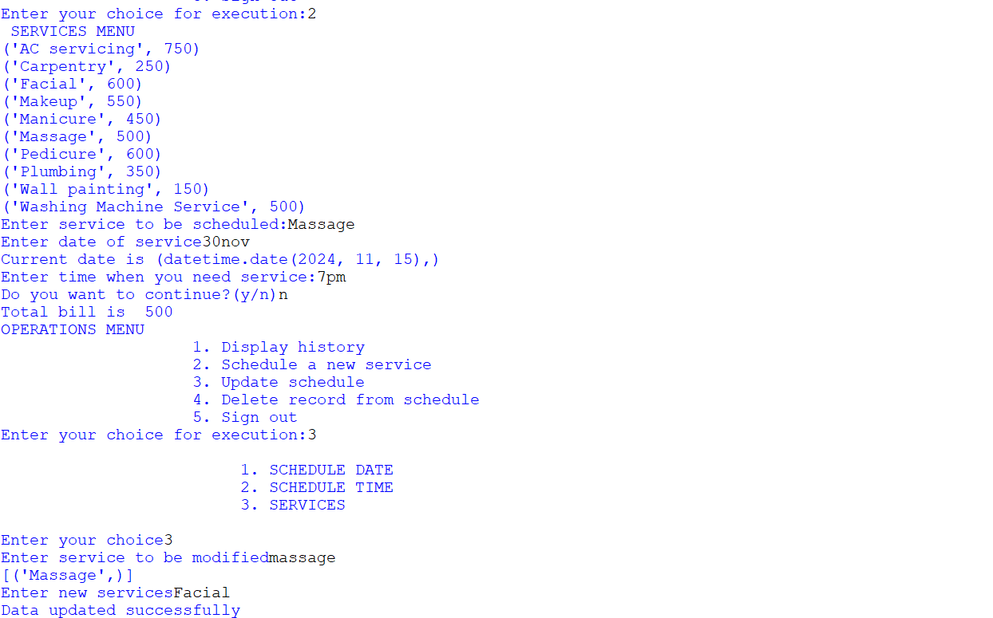
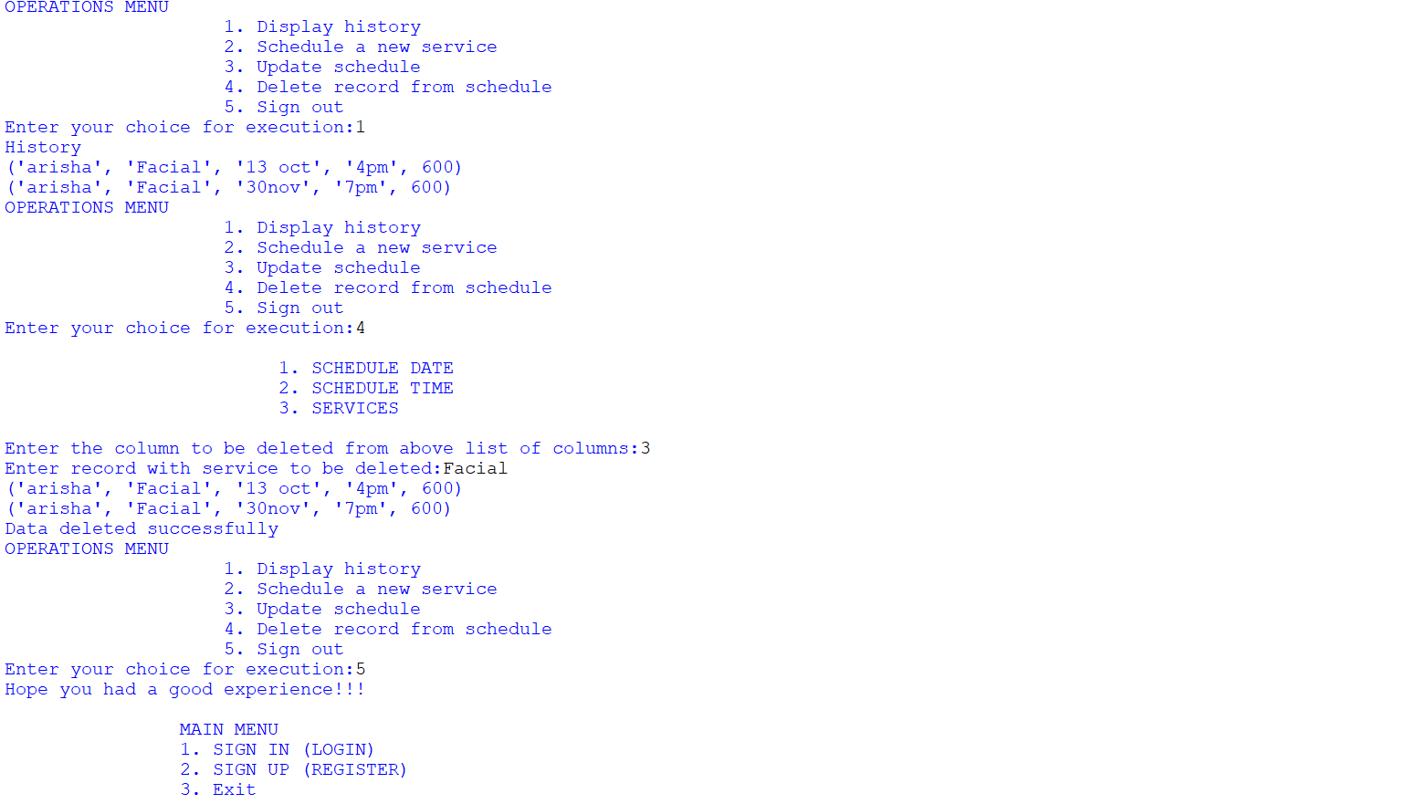
Login Screen
The login screen allows users to enter their credentials to access the application.
Service Selection
Users can browse and select from a variety of services offered by the platform.

Slide 10
User Interface
Welcome Screen
The application starts with a welcome screen, guiding users to the main menu.
Main Menu
The main menu offers options for sign-in, sign-up, and exiting the application.
User Login
Logged-in users can access features like viewing history, selecting services, scheduling appointments, and managing payments.
Service Options
Users can choose from a variety of services, including beauty treatments, massages, home cleaning, and more.
Booking and Payment
Users can book services, schedule appointments, and make payments securely through the platform.

Slide 11
Future Enhancements
Real-time Tracking
Implement real-time tracking of service providers, allowing users to monitor their progress.
Customer Reviews
Enable users to leave reviews and ratings for service providers, enhancing transparency and trust.
Personalized Recommendations
Develop a system that suggests services based on user preferences and past bookings.
In-App Chat
Introduce an in-app chat feature for direct communication between users and service provider

Slide 12


